Slide 1
TaskMaster
TaskMaster is a comprehensive task management application designed to help individuals and teams organize their tasks efficiently across multiple platforms.
Group 1
Harichaithanya Kotapati (S567067)
Teja Kumar Muppala (S565960)
Manichandra Kuntala (S565945)
LaxmiNarayana Yadav Pakanati (S564223)
Vaishnavi Inturi (S567121)

Slide 2
Agenda
Outline
Introduction
Problem Statement
Use Cases
Functional Requirements
Non-Functional Requirements
Architecture plan
Data management plans
Prototype demos
What has been accomplished?
Fall 2024 plan
Reference

Slide 3

Outline
TaskMaster is an app that helps individual, or team organize and manage tasks efficiently across different devices.
TaskMaster can create tasks, set deadlines, and collaborate with others to ensure everything gets done smoothly and on time.

Slide 4
Introduction
The features of TaskMaster include :
Task creation
Assignment
Prioritization
Tracking
Collaboration
With clean and intuitive user interface.
TaskMaster is ideal for modern productivity because it is scalable, secure, and easy to use for managing tasks.
TaskMaster ensures it is always accessible, can handle growth, and works quickly on web platforms.
It requires secure logins, safe task storage, instant updates, and strong security.

Slide 5
Problem Statement
Individuals and teams struggle with efficiently organizing and managing tasks across multiple devices.
Existing solutions often lack:
Comprehensive features
Scalability
Security
Intuitive interfaces
Taskmaster aims to address these issues by providing a task management application that:
Allows users to create, assign, prioritize, and track tasks
Enables setting deadlines and reminders
Facilitates team collaboration
Provides secure data handling

Slide 6
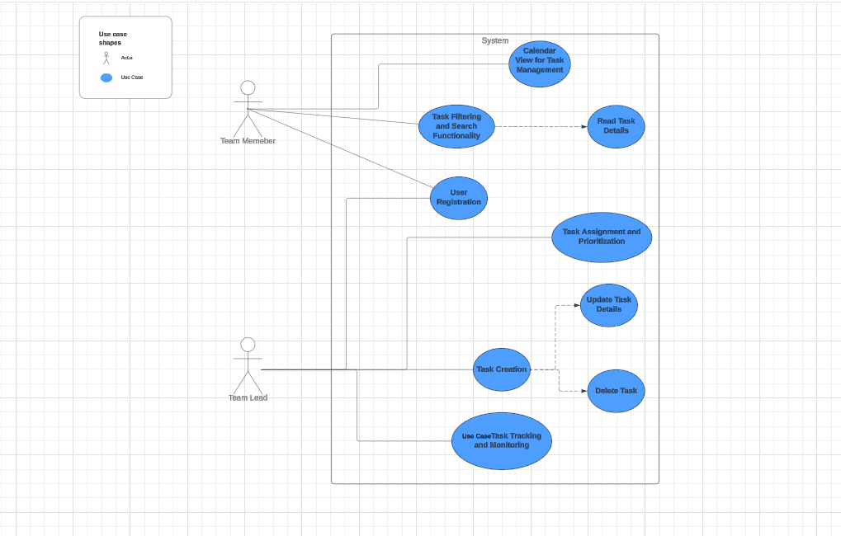
Use Cases

Slide 7
Functional Requirements
Create tasks based on user input.
Assign tasks to specific users or teams.
Prioritize tasks according to user-defined criteria.
Secure user authentication and authorization.
Store and retrieve task data securely.
Provide a clean and intuitive user interface for easy navigation and task management.

Slide 8
Functional Requirements
Offer tasks lists, filter and search functionality.
Display tasks and their deadlines in a calendar view
Allow team members to collaborate on tasks by sharing updates and comments.
Encrypt and store the Passwords securely
Enable the users to reset their passwords.
Store the user’s actions after logging in.

Slide 9
Non-Functional Requirements
Role-based access control to manage user permissions.
MySQL Database scalability to accommodate the growing volume of task data and users.
Encryption of sensitive task data to protect against unauthorized access.
Implementation of secure protocols for user authentication and session management.
The application should be compatible with a wide range of web browsers (Chrome, Firefox, Safari, Edge).
High availability and reliability.
Scalability to accommodate an increasing user base.

Slide 10
Architecture plan
Design patterns to be used
Model-View-Controller (MVC) Design Pattern
Organizes code into three interconnected components: Model, View, and Controller.
Enhances maintainability and scalability of applications.
Separates UI layer , Database Layer and Service layer.
Model: Represents data and business logic.
View: Displays user interface elements.
Controller: Handles user inputs and interactions.

Slide 11
Platforms and Technologies
Tools :
Eclipse
MySQL Workbench
Postman
Git Desktop
Frontend Technologies:
Html
Version Control:
Git
Backend Technologies :
Java
Spring Boot Framework
Database:
MySQL
CSS
JavaScript
Bootstrap
Thymleaf

Slide 12
Architecture plan
Third-party libraries to provide functionality:
Spring Security
Spring Data JPA
BCryptPasswordEncoder
Email service
Logging frameworks like Logback or Log4j
Hosting strategy and requirements:
Offer a fully managed platform with serverless architecture, ensuring high availability and reliability for hosting services.

Slide 13
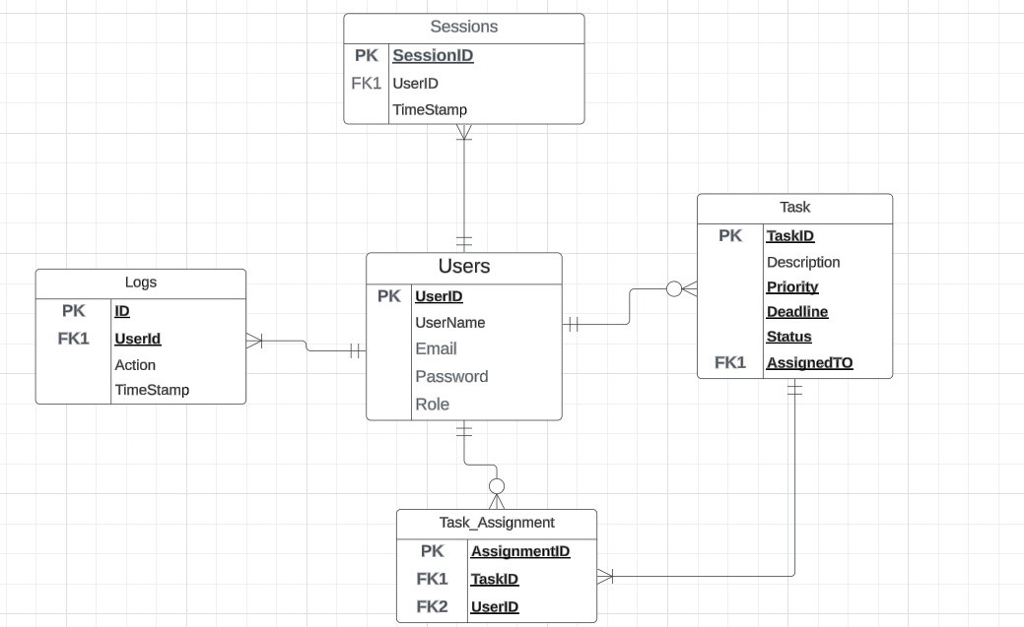
Data Management Plan
Features :
Task Management
Collaboration
Security

Slide 14
Prototype demos
Created Login prototype
Created Registration prototype

Slide 15
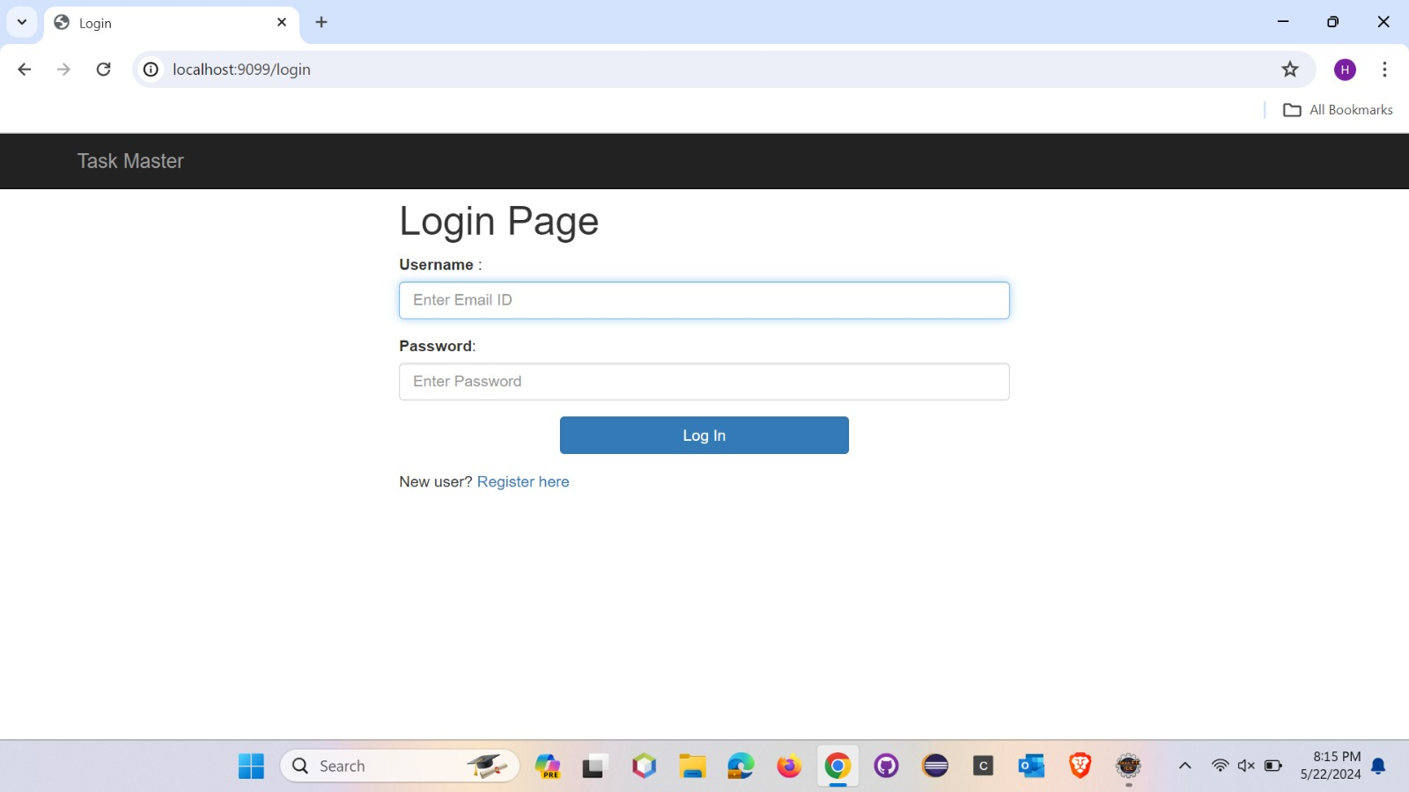

Slide 16
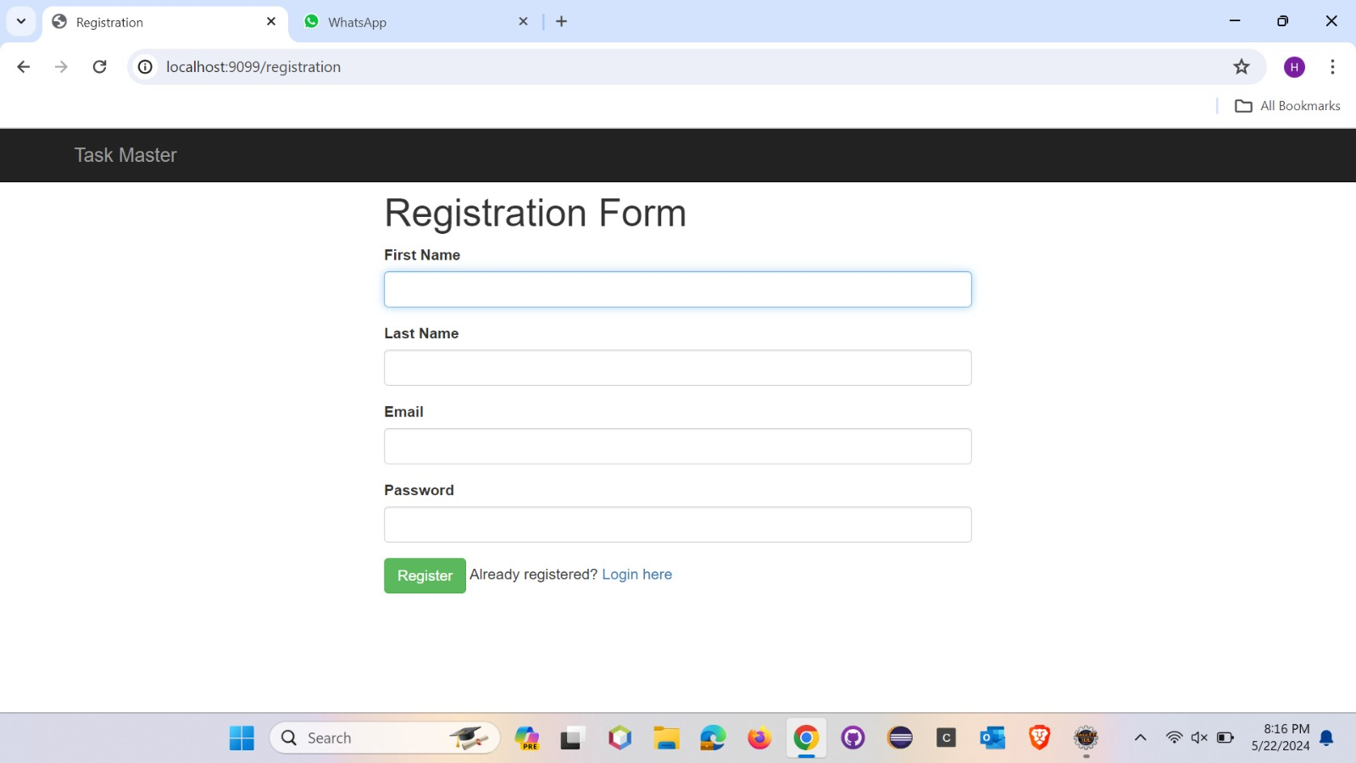

Slide 17
What has been accomplished?
Functional and Non-Functional requirements
Use Cases Documentation
Developed Data Plan for keeping track of all the data
Create a full set of seed data (or "dummy data") based on the schema
Prototype of Login and Registration page

Slide 18
Fall 2024 plan
Finalize Graphical User Interface designs.
Develop core features in line with project requirements.
Conduct user testing to validate functionality and gather feedback.
Iterate and refine based on user input and testing results.
Integrate third-party services seamlessly to enhance functionality.
Backend (spring boot, MYSQL).
Frontend (HTML,CSS and Bootstrap)
Perform thorough testing.
Prepare for deployment in Render.
Document development processes and provide comprehensive training materials.

Slide 19
Reference:
Spring boot: https://docs.spring.io/spring-framework/docs/6.0.0/reference/pdf/spring-framework.pdf
Java: https://docs.oracle.com/en/java/
Angular: https://v17.angular.io/docs
Render: https://docs.render.com/
Bootstrap CSS: https://getbootstrap.com/docs/3.4/css/
MVC Pattern: https://developer.mozilla.org/en-US/docs/Glossary/MVC

Slide 20
Thank you
Team:
Harichaithanya Kotapati (S567067)
Teja Kumar Muppala (S565960)
Manichandra Kuntala (S565945)
LaxmiNarayana Yadav Pakanati (S564223)
Vaishnavi Inturi (S567121)

